Slide 1
Fiber Design
Logging changes

Slide 2
Gas cell
Gas cell from guiding Photonics
Holds ends of fiber
Swagelok connections on both
https://guidingphotonics.com/gas-cells/#Blocks
Should both gas cells be mounted on a translation stage?
If so how many axes?

Slide 3
CF attachment to gas cell
I made an adapter to connect a 1.33” CF bellow to the gas cell
Seal with an o-ring https://www.lesker.com/vacuum-flanges-components.cfm?section=elastomer-o-rings
Notes:
With this I could just use a bellow with the correct length and mount the window at the end of it. Need adapter for bellow to window mount.
O-ring OD is .845”. There are many kinda of materials we can choose from on KJL. I think FKM or nitrile are our best bets.

Slide 4
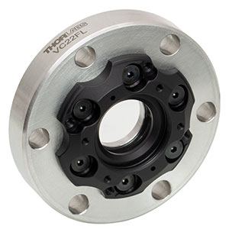
Laser Window Mount
Mount CF flange that holds window onto bellow
Specs say a 5mm window is required, but I would like to mount a 3mm window
https://www.thorlabs.com/thorproduct.cfm?partnumber=VC22FL

Slide 5
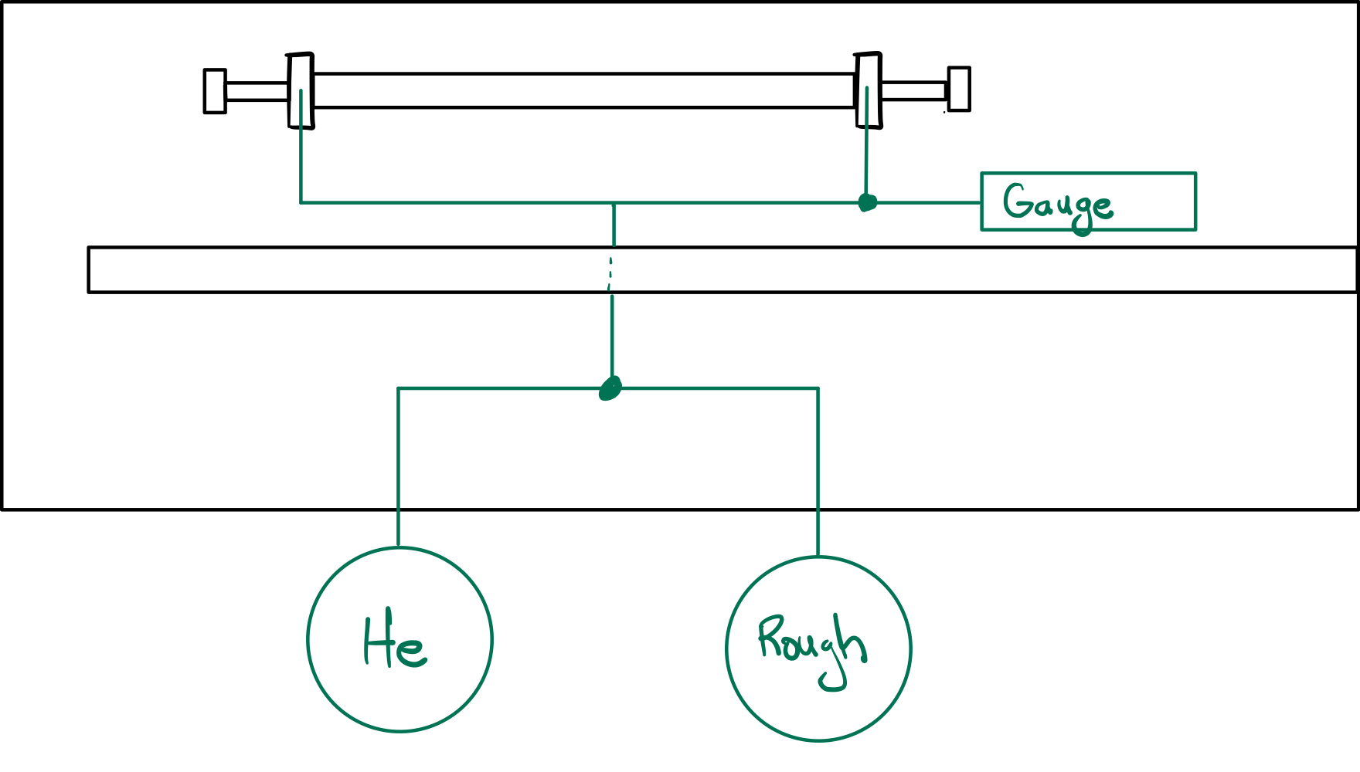
Gas/Vacuum Delivery
Vacuum/Helium
Helium: need to buy? Gerard says PBPL has some
Rough vacuum: get a rough pump
Need Swagelok to connect and a valve to switch between vacuum to evacuate and He to fill
Cold cathode gauge should work, it needs to read up to 1 atm and rough vacuum

Slide 6
Legend beam
800nm central wavelength
1mJ per pulse
40fs pulse duration
w = 3.75mm (measured with DataRay camera)

Slide 7
SHG
Assume type 1 SHG in BBO happens w/ efficiency of 50%
BBO we have has an aperture of 6mm x 6mm so we will likely clip our beam
We then have .5mJ of both 800nm IR & 400nm blue light to couple into fiber
Notes:
Need to actually measure these values
Clipping might occur, maybe with telescope it might not happen
I currently am using the SHG crystal from the Eskma optics FKE-800-100-M set (says aperture is 6mm x 6mm)

Slide 8
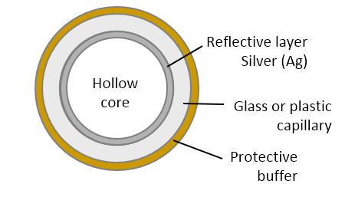
Fiber
Purchased from guiding Photonics
https://guidingphotonics.com/hollow-fibers-optics-solutions-for-uv-and-visible-nir/
30 cm long
ID of 200 um
Inside is lined with silver
Notes:
Parameters chosen to maximize UV produced

Slide 9
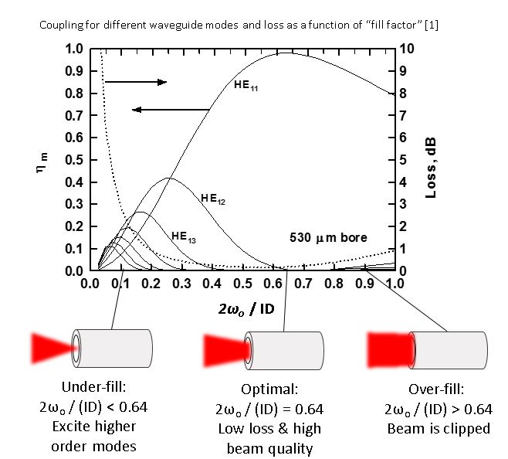
Coupling light into fiber
To best excite HE11 mode our gaussian beams should have a radius:
w = .64*(fiber radius) = 64 um
Notes:
Cite paper

Slide 10
Focusing light into fiber
We need to choose a lens to focus light into fiber
We choose f = 75cm
Determines necessary spot size of beams incident on lens
w_IR = 2.98 mm
w_Blue = w_IR /2 = 1.49 mm
Will be mounted on a translation stage
Should it also have x & y translation?
Notes:
Again, the IR light will clip on our BBO crystal

Slide 11
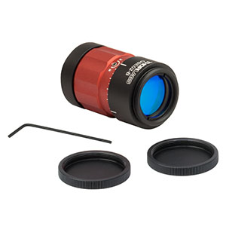
Beam Reducers
To adjust IR light to proper size we need a telescope that gives w -> .8w
f1 = 125 mm
https://www.thorlabs.com/thorproduct.cfm?partnumber=LA4236-B
f2 = -100 mm
https://www.thorlabs.com/thorproduct.cfm?partnumber=LC1120-B
Mount in a cage? Lens tube?
Blue light needs w -> .5w so we can use a pre-built telescope
https://www.thorlabs.com/thorproduct.cfm?partnumber=GBE02-B
Will telescopes need x & y translation stages?
Notes:
IR telescope can be mounted in a cage (then we need at least a z translation cage mount, which we have but it’s incomplete), or in an adjustable lens tube
UVFS lenses are more expensive and I think I can get N-BK7 lens https://www.thorlabs.com/thorproduct.cfm?partnumber=LA1986-B

Slide 12
Nonlinear effects from focusing
We will then see around 10 GW at the fiber entrance, this is not enough to ionize helium
We need to worry about the B integral in the laser windows as well
Notes:
Cite the ionization of helium

Slide 13
B-Integral
The wavelengths and pulse duration effect n₂, for UVFS a shorter wavelength and/or pulse duration makes n₂ larger.
Material | Window Thickness (mm) | n₂*10⁻²⁰ (m²/W) | Source
UVFS | 1,3,5 | 3-5 | 1,2,3,4
Calcium Fluoride (CaF₂) | 3,5 | 1.71 | 2,5
Magnesium Fluoride (MgF₂) | 3,5 | 1 | 1,5
Sapphire | 3,5 | 2.8 | 2
Trenton R. Ensley and Neal K. Bambha, "Ultrafast nonlinear refraction measurements of infrared transmitting materials in the mid-wave infrared," Opt. Express 27, 37940-37951 (2019)
https://www.rp-photonics.com/nonlinear_index.html their numbers have actual sources
James Amoani , “Intensity dependent nonlinear refractive index of fused silica”, Thesis
D. Milam, “Review and assessment of measured values of nonlinear refractive index coefficient of fused silica,” Opt. Express. 12, 1377–1382 (2004).
D. Milam, M. J. Weber, and A. J. Glass , "Nonlinear refractive index of fluoride crystals", Appl. Phys. Lett. 31, 822-825 (1977) https://doi.org/10.1063/1.89561

Slide 14
Entrance Window
Using a 3mm MgF2 window we can have the B integral < pi
https://www.thorlabs.com/thorproduct.cfm?partnumber=WG61050
Notes:
This assumes we have .5 mJ of IR and blue light, we will likely have less

Slide 15
Exit Window
I’m not sure what the beam looks like exiting the fiber.
Is the beam Gaussian?
Will it diverge or will it stay collimated with the small spot size of the fiber diameter?
Notes:
There will still be around 1 mJ of total light leaving the fiber.

Slide 16
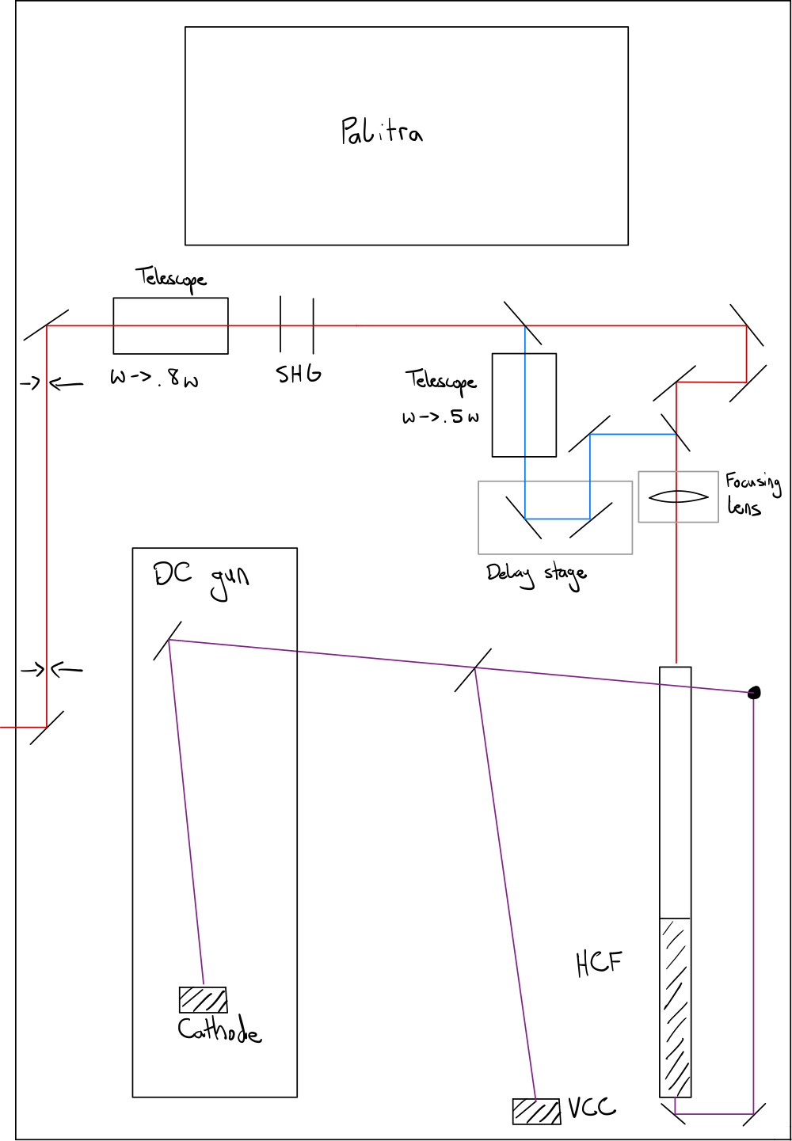
Optical Design
Sketch of layout of optics
Dimensions have been checked to confirm that there’s enough space on the table

